Slide 1


Lewis Chukwuma
11th October, 2024

Slide 2

Outline
Executive Summary
Introduction
Methodology
Results
Conclusion
Appendix

Slide 3
Executive Summary
SpaceX advertises falcon 9 launches on its website having a cost of 62 million dollars whereas other providers cost upward of 165 million dollars each for the same thing. What makes SpaceX stand out? Its due to the fact that they reuse the first stage by making sure the first stage lands successfully saving them millions of dollars. This information from SpaceX REST API can also be used to reduce costs for SpaceY and improve competition.
Research has been carried out, models have been trained and tested and results show that there is an 83% chance that the first stage will land successfully using Logistic Regression, SVM and KNN, but all these rely heavily on criterias such as booster version, payload mass, orbit, launch site etc.

Slide 4
Introduction
Commercial space age is here and companies are making space travel affordable for everyone. The front runner of it all is SpaceX and some of their accomplishments include sending spacecraft to the international space station, Starlink which is a satellite internet constellation providing satellite internet access and sending manned missions to space. The reason why SpaceX is able to do this is because their rocket launches are relatively inexpensive. They advertise falcon 9 launches at a cost of 62million dollars while other providers cost an upward of 165 million dollars and it is due to the fact that unlike other providers, SpaceX’s falcon 9 can recover its first stage, thereby saving a lot of money. Here we would like to understand the factors that can guarantee a successful first stage landing.
Some questions we would like to find answers to include, how the launch site affects the landing, how the payload mass affects the landing, how the orbit type affects the landing, how the booster affects the landing, how these factors affect each other and also predicting the outcome of a launch by modelling all these factors from historic data.

Slide 5

Section 1

Slide 6
Methodology
Executive Summary
Data collection methodology:
Like every other leading company in the world, SpaceX store their data and this can be gotten by requesting rocket launch data from SpaceX API using a GET request with the following URL; “SpaceX data link”
Perform data wrangling
Next we have to clean the data such as removing unnecessary data and removing missing values in the data set and then extract falcon 9 launch records with Beautiful Soup
Perform exploratory data analysis (EDA) using visualization and SQL
Perform interactive visual analytics using Folium and Plotly Dash
Perform predictive analysis using classification models
Using models such as Logistic Regression, SVM, Decision Tree Classifier and KNN to train and test the data to see if it will be able to predict data outside the training set.

Slide 7
Data Collection
Like every other leading company in the world, SpaceX store their data and this can be gotten by requesting rocket launch data from SpaceX API using a GET request with the following URL; “SpaceX data Link”
Request and parse rocket launch data from SpaceX API using GET
Clean the data to only include falcon 9 launches
Clean the data to replace missing values
Request falcon 9 launch wiki page using GET method
Create dataframe by parsing launch HTML tables
Extract column names from HTML table header using beautiful soup

Slide 8
Data Collection – SpaceX API
Lewis Chukwuma Data Collection- API link
Request and parse data using GET request
Clean the data to include only falcon 9 launches
Clean the data to replace missing values

Slide 9
Data Collection - Scraping
Lewis Chukwuma Data Collection - Scraping link
Request falcon 9 launch wiki page using GET
Extract column names from HTML table header using Beautiful Soup
Create dataframe by parsing launch HTML tables

Slide 10
Data Wrangling
Performing Exploratory data analysis, it is important to find some patterns in the data to determine the label for training supervised models. There are several different cases where the booster did not land successfully due to an accident, so we transformed those training labels with 1 which means the booster successfully landed and 0 which means it was unsuccessful
Lewis Chukwuma Data Wrangling link
Calculate the number of launches on each site
Calculate the number and occurrence of each orbit
Calculate the number and occurrence of mission outcome of the orbits
Create a landing outcome label from outcome column

Slide 11
EDA with Data Visualization
Plotting the relationship between parameters such as FlightNumber and LaunchSite, Payload Mass and Launch Site, FlightNumber and Orbit type, Payload Mass and Orbit type because we want to observe if there is any relationship between any of them and then the success rate of each orbit type and also visualize the launch success yearly trend to visually check if there are any relationships between success rate and orbit type and to also observe the yearly success trend.
Lewis Chukwuma EDA with Visualization link

Slide 12
EDA with SQL
Displayed the names of unique launch sites in the space mission
Displayed 5 records where launch sites begin with the string “CCA”
Displayed the total payload mass carried by boosters launched by NASA (CRS)
Displayed average payload mass carried by booster version F9 v1.1
Listed the date when the first successful landing outcome in ground pad was achieved
Listed the names of the boosters which have success in drone ship and have payload mass greater than 4000 but less than 6000
Listed the total number of successful and failure mission outcomes
Listed the names of booster versions which have carried the maximum payload mass
Listed the records that will display the month names, failure landing outcomes in drone ship, booster versions, launch site for the month in year 2015
Ranked the count of landing outcomes between the dates 2010-06-04 and 2017-03-20 in desc order
Lewis Chukwuma EDA with SQL link

Slide 13
Build an Interactive Map with Folium
Firstly we marked all launch sites on the map using the sites longitude and latitude coordinates then we visualized it on the map by pinning them but to make it easier to pin point on the map, we added circles and markers in places such as CCAFS LC-40, CCAFS SLC-40, KSC LC-39A, VAFB SLC-4E launch site coordinates. Next we enhanced the map by adding the launch outcomes for each site and created markers for class = 1 to represent green and class = 0 to represent red. Lastly we analyzed and explored the proximities of launch sites using polyline and also used mouseposition to find coordinates on the map
Lewis Chukwuma Interactive Visual Analytics with Folium link

Slide 14
Build a Dashboard with Plotly Dash
I created a pie chart and scatter plot to interact with the data, whereas the piechart showed the success count for all launch sites and also individual launch sites. The dashboard also contains a drop-down list and a range slider so as to be able to select and view each launch sites and also select a payload range respectively. All these was done so as to answer questions such as which site has the largest successful launches, which site has the highest launch success rate, which payload range has the highest launch success rate, which payload range has the lowest launch success rate and which F9 booster version has the highest launch success rate.
Lewis Chukwuma Interactive Dashboard with Plotly Dash link

Slide 15
Predictive Analysis (Classification)
First you have to create a Numpy array from the column class in data by applying the method to_numpy() and assign it to a variable, then standardize the data and split it into training and testing data, then create a logistic regression object, support vector machine object, decision tree classifier object and K-nearest neighbor object which will be used to train the data and after each model, testing is done by calculating the accuracy on the test data. Finally the best model is selected by selecting the model closest to 100%.
Lewis Chukwuma Machine Learning Prediction link
Create a column for the class in data
Standardize the data
Split the data into training and testing data
Find the best hyperparameters for SVM, decision tree classifier and logistic regression
Find the method that performs best using test data

Slide 16
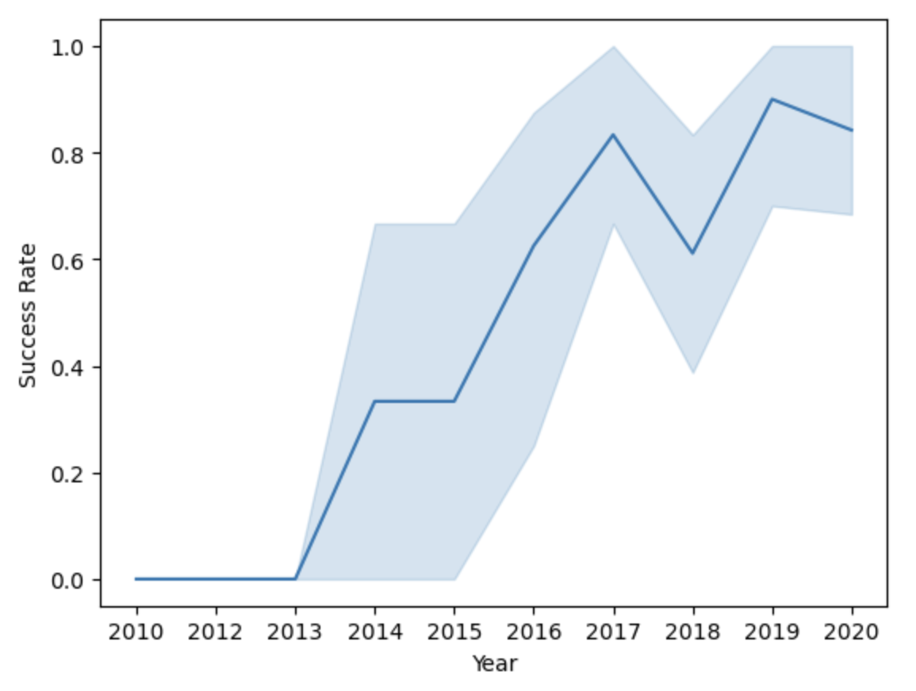
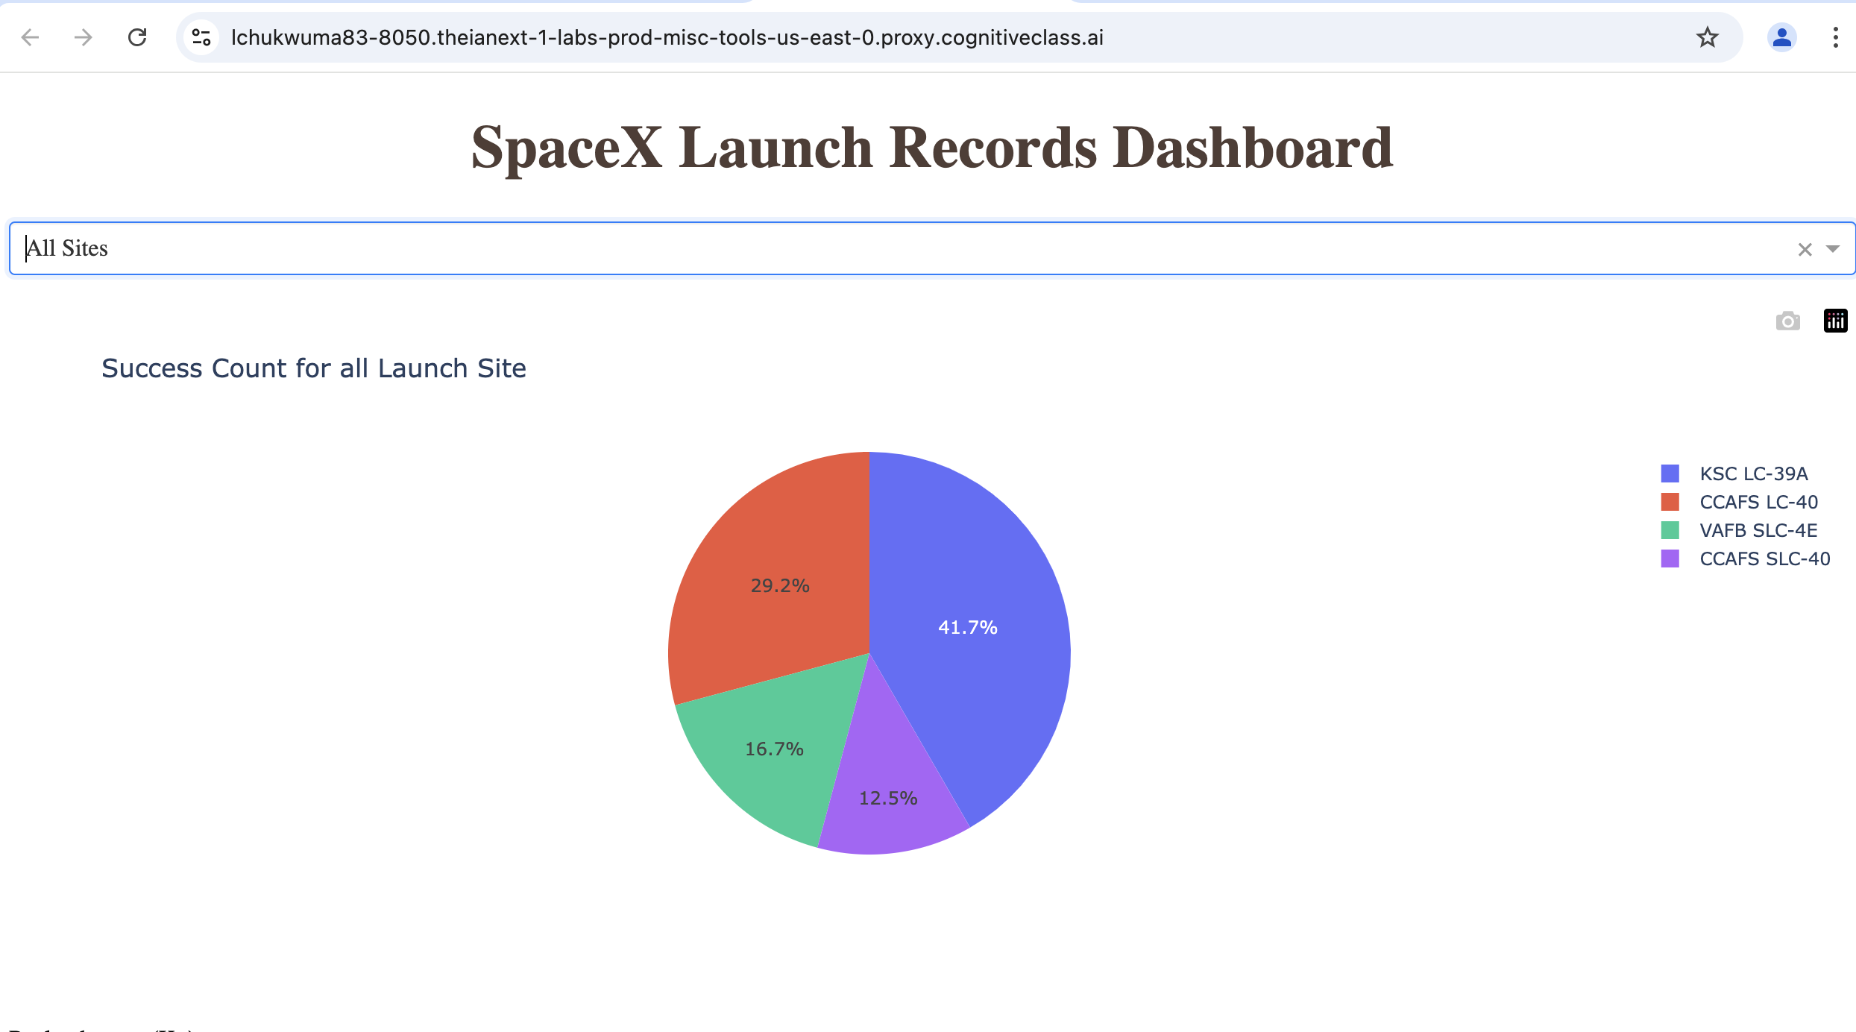
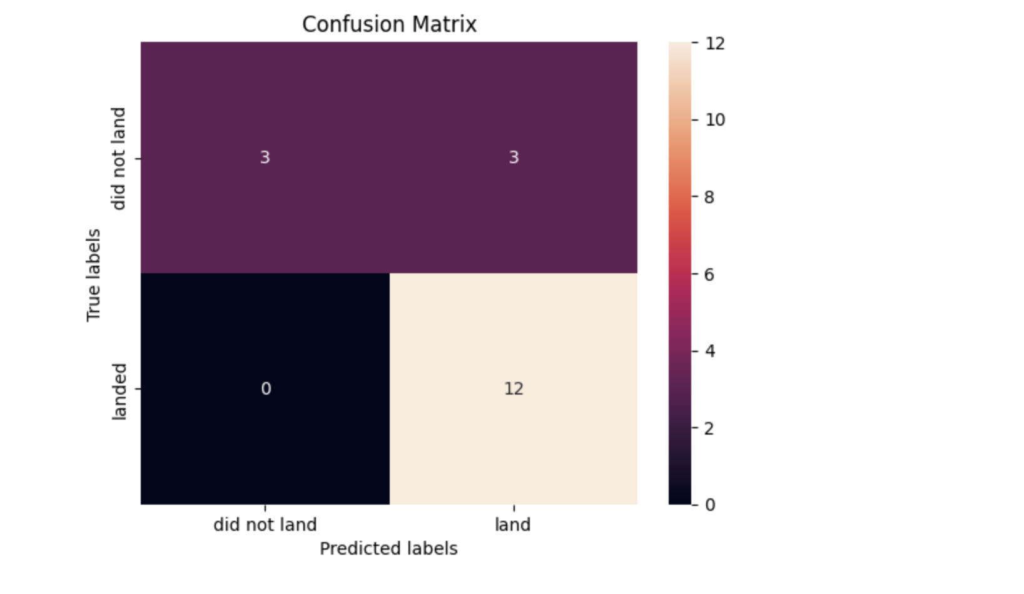
Results

Slide 17

Section 2

Slide 18
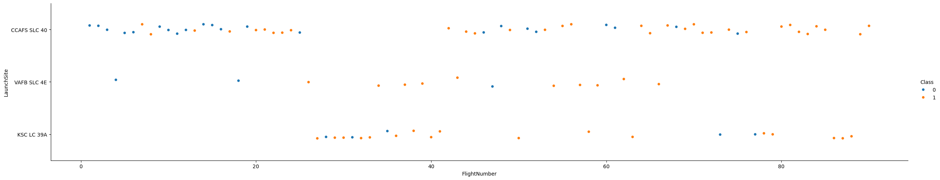
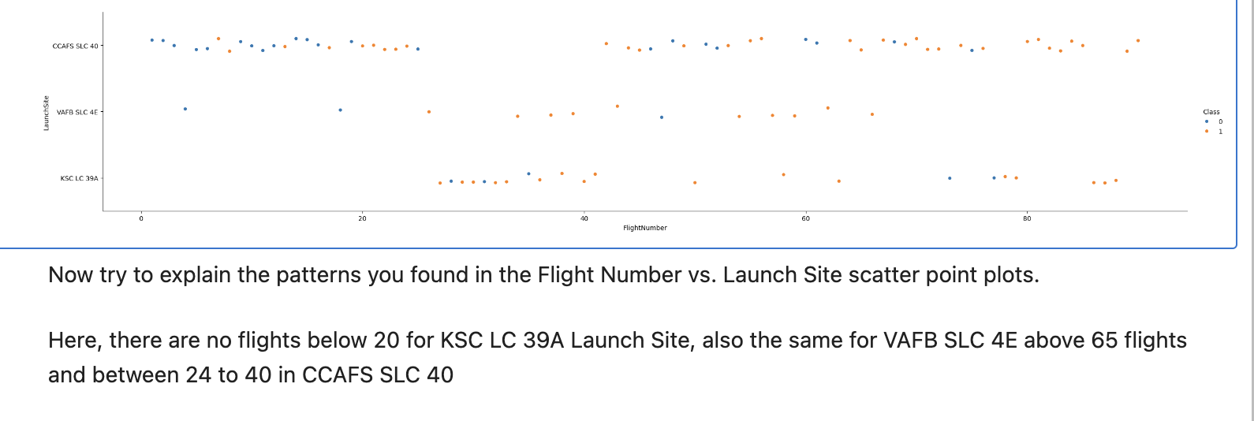
Flight Number vs. Launch Site
Flight Number vs. Launch Site
Scatter plot with explanations

Slide 19
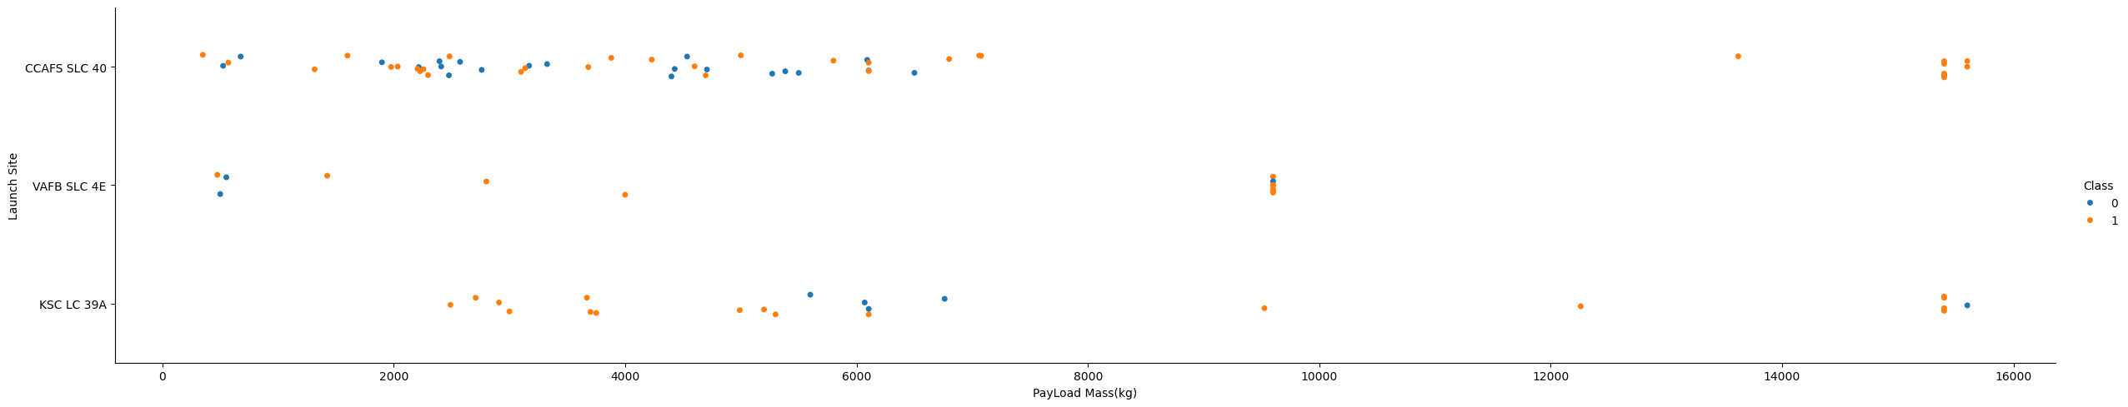
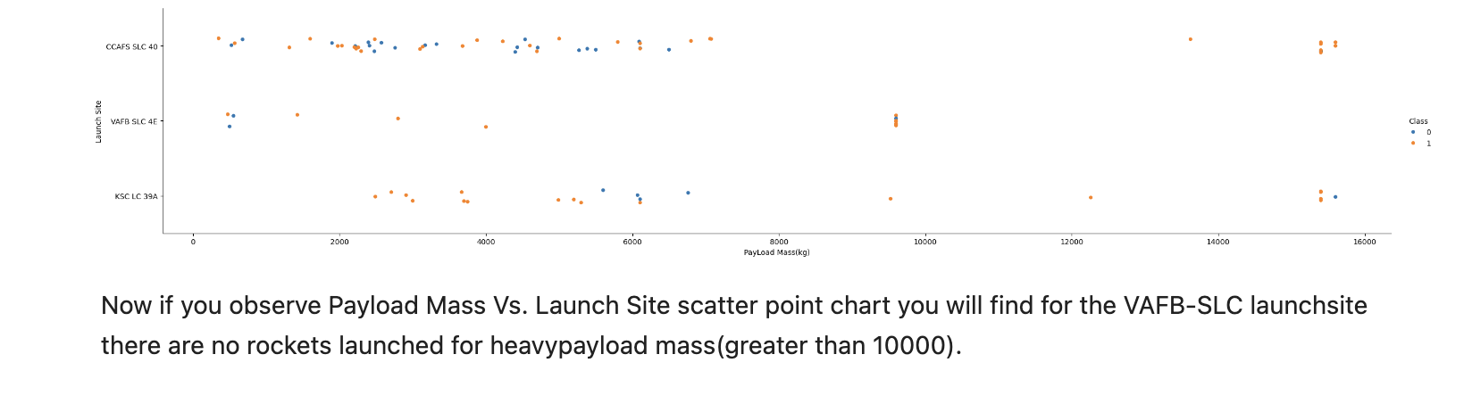
Payload vs. Launch Site
Payload vs. Launch Site
Scatter plot with explanations

Slide 20
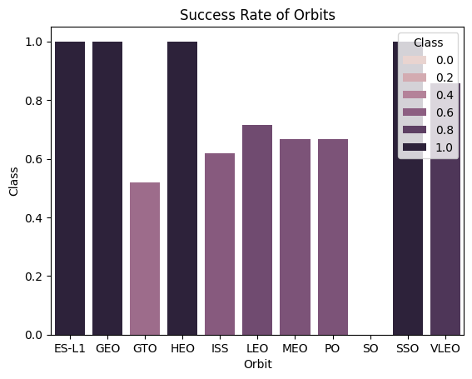
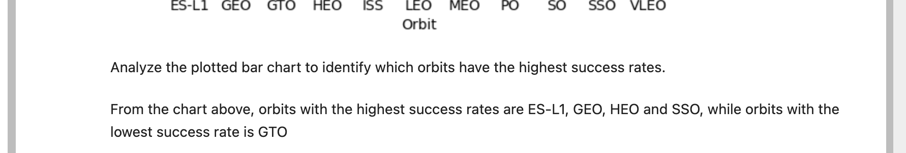
Success Rate vs. Orbit Type
Success rate of each orbit type
Scatter plot with explanations

Slide 21
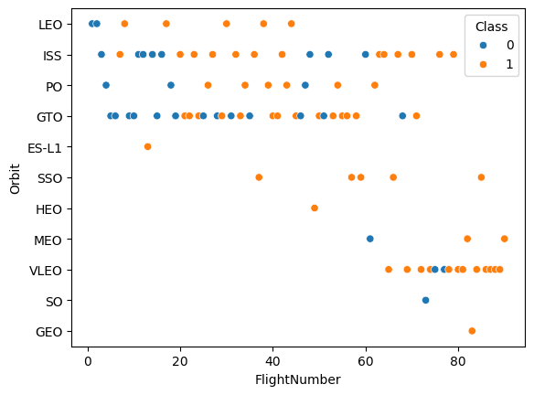
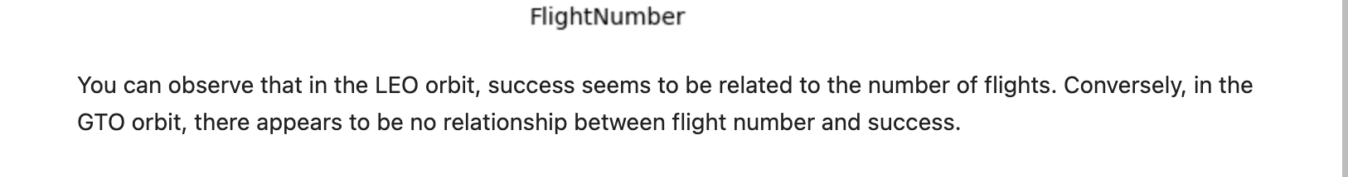
Flight Number vs. Orbit Type
Flight number vs. Orbit type
Scatter plot with explanations

Slide 22
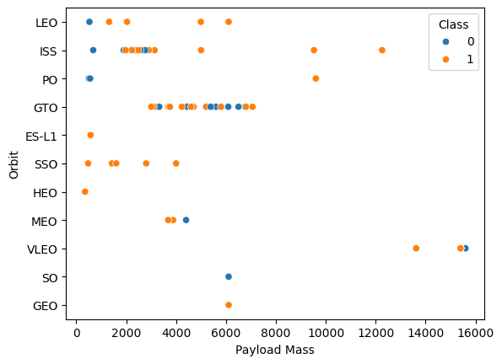
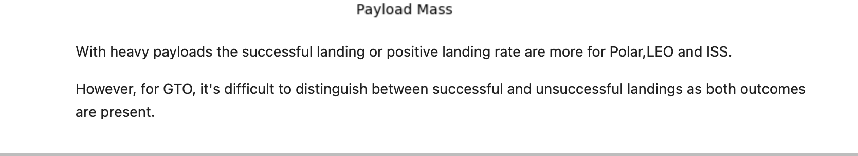
Payload vs. Orbit Type
Scatter point of payload vs. orbit type
Scatter plot with explanations

Slide 23
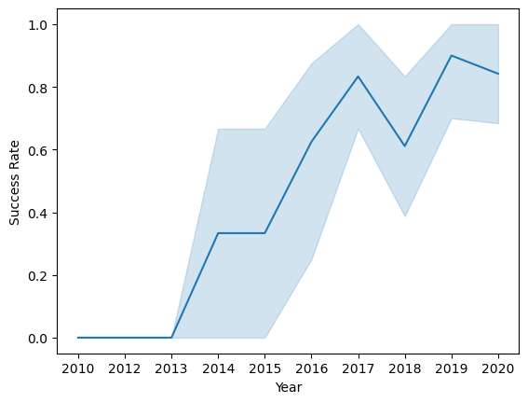

Launch Success Yearly Trend
Line chart of yearly average success rate
Line chart with explanations

Slide 24
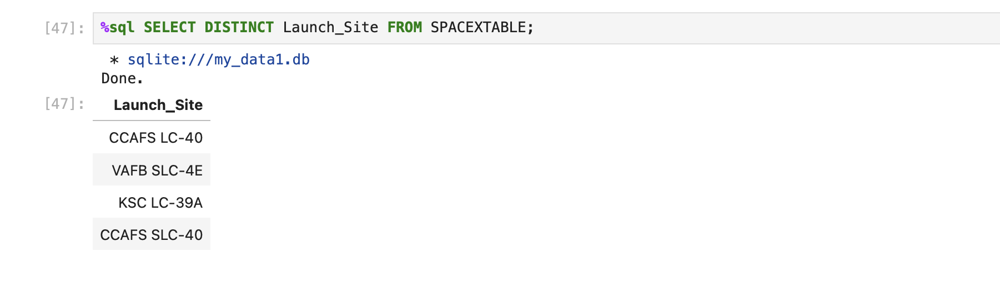
All Launch Site Names
Names of the unique launch sites
The result shows all the unique launch sites, instead of repeating them because of the keyword DISTINCT, as it is used to display words once instead of repeating it according to how many times it was shown on the table.

Slide 25
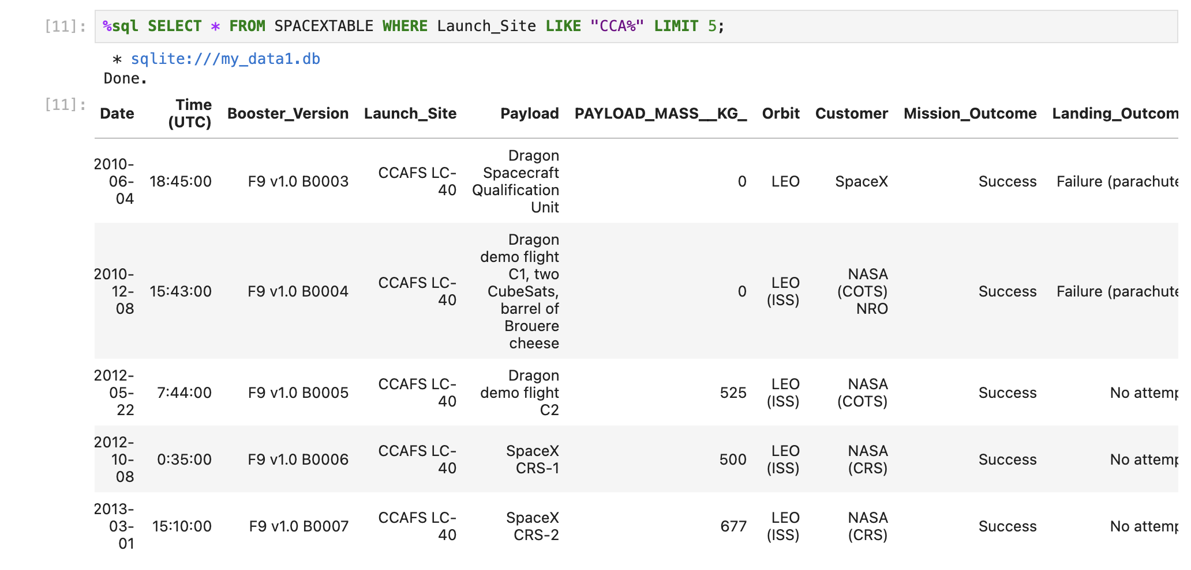
Launch Site Names Begin with 'CCA'
From the table, you have to select all launch sites that begin with CCA by using * and the keyword WHERE as it is used to meet a condition and that condition is to find sites beginning with CCA and you use the % symbol to fill up unknown words when searching for a keyword and lastly you use LIMIT because you are only looking for specific number of records and not all the records.

Slide 26
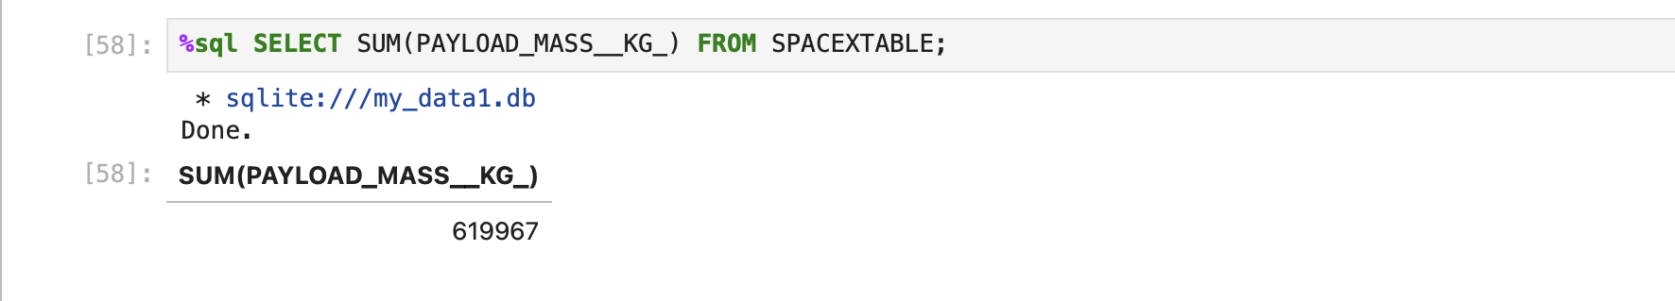
Total Payload Mass
The total payload carried by boosters from NASA
To get the total of a column, you have to make use of the SUM() keyword, with the name of the column inside the parenthesis and ofcourse direct it to the table name using the keyword FROM.

Slide 27
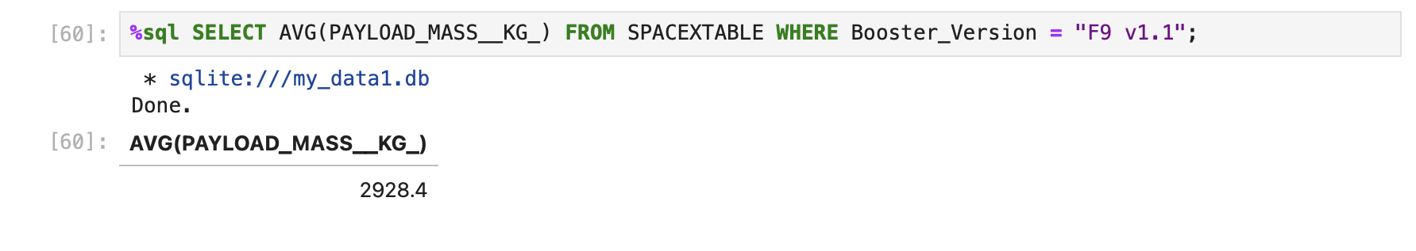
Average Payload Mass by F9 v1.1
The average payload mass carried by booster version F9 v1.1
To calculate the average of a column, you have to make use of the AVG() keyword with the name of the column inside the parenthesis but since we are looking for the average payload mass of a specific booster version which is F9 v1.1, we have to use the conditional keyword WHERE to assign the average to booster version F9 v1.1 only.

Slide 28
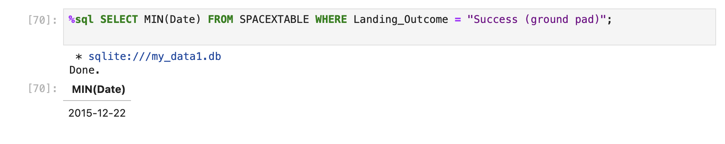
First Successful Ground Landing Date
The date of the first successful landing outcome on ground pad
To find the first successful landing outcome, you have to make use of the keyword MIN() as this will take you to the lowest point but in this case the first date, also you have to make use of the conditional keyword WHERE as we are asked to find a specific location which is ground pad, that was success.

Slide 29
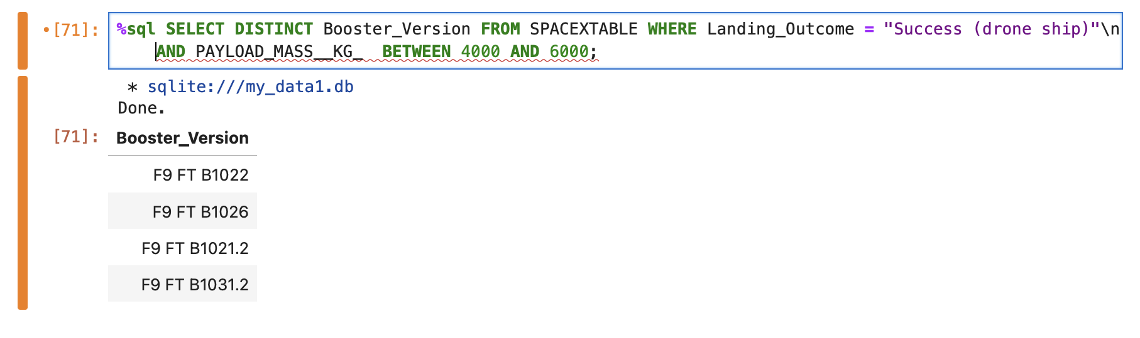
Successful Drone Ship Landing with Payload between 4000 and 6000
The names of boosters which have successfully landed on drone ship and had payload mass greater than 4000 but less than 6000
Here we have to make use of the keyword DISTINCT so as to get unique booster versions and then a conditional keyword because we are looking for a specific location which is drone ship and lastly BETWEEN because we are trying to find values between two values which is 4000 and 6000.

Slide 30
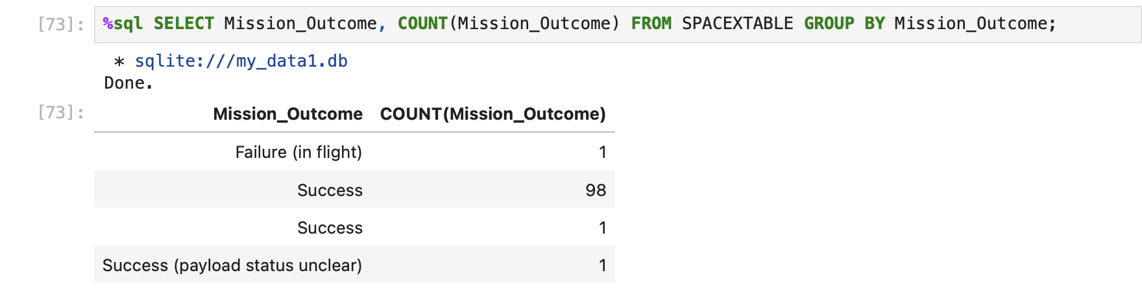
Total Number of Successful and Failure Mission Outcomes
The total number of successful and failure mission outcomes
Here we are trying to get the total number of mission outcomes, so we have to use the COUNT() keyword with the column name inside the parenthesis and we also need it to be grouped according to the success and failure outcomes using the keyword GROUP BY.

Slide 31
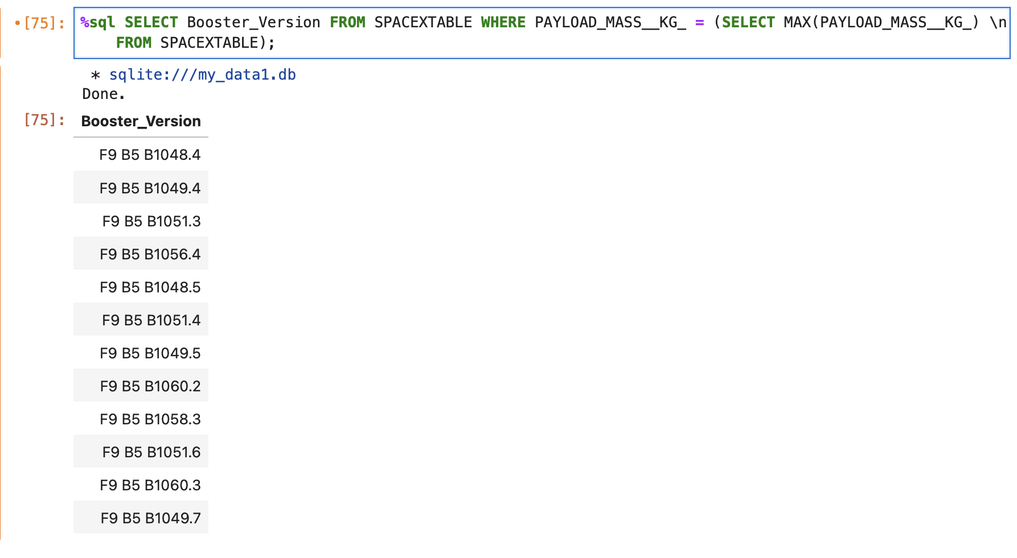
Boosters Carried Maximum Payload
To, find the boosters that carried max payload, we have to make use of a conditional keyword such as WHERE on the column we are looking into, the max() keyword to find the maximum and the column name placed inside the parenthesis and all this would be gotten from the table SPACEXTABLE.

Slide 32
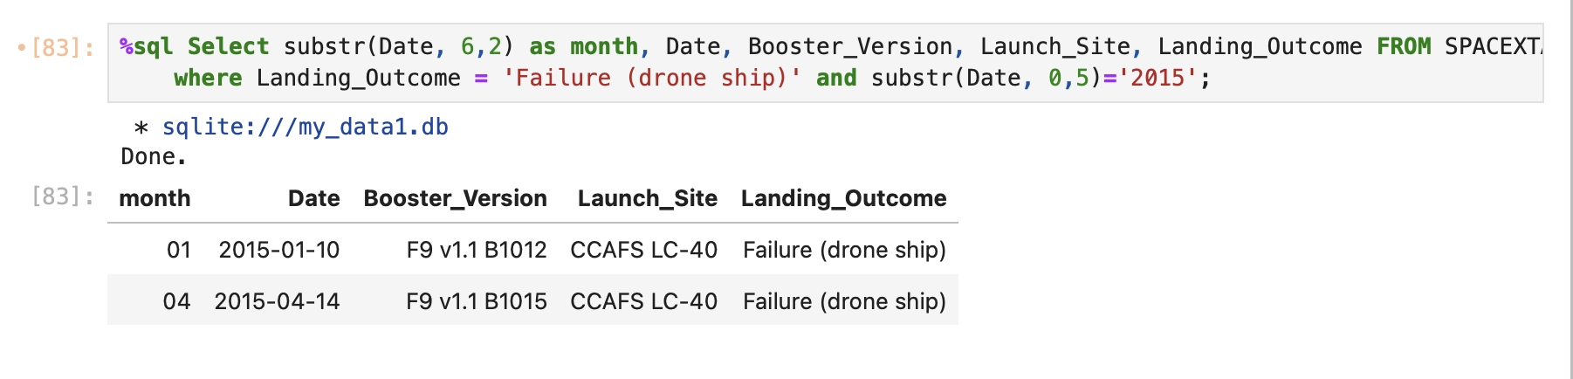
2015 Launch Records
The failed landing_outcomes in drone ship, their booster versions, and launch site names for in year 2015
Here, we have to select several columns such as date, booster versions, launch site, landing outcome of the record from 2015 making use of the conditional keyword WHERE to query the result to only provide records from the failed drone ship landing outcome.

Slide 33
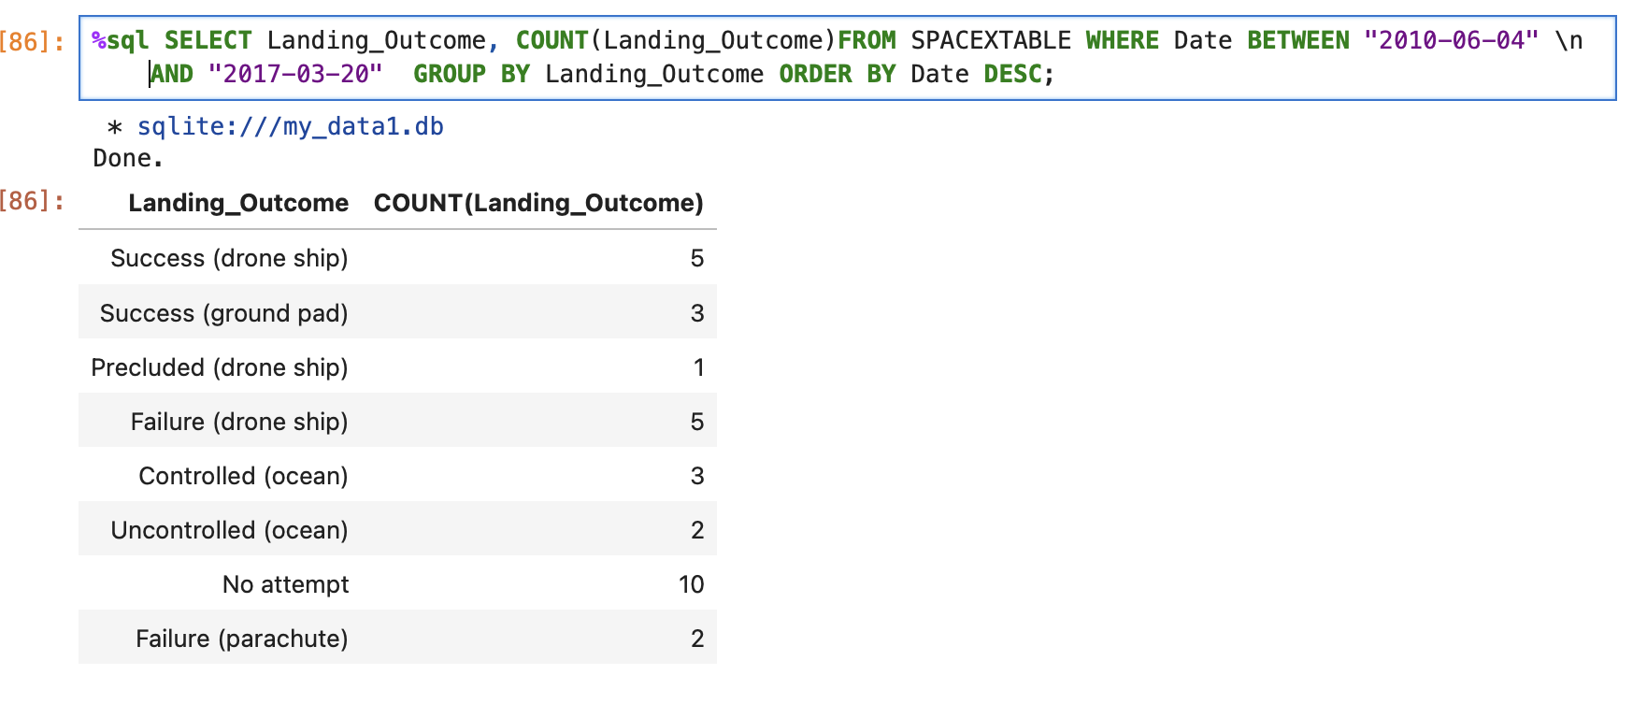
Rank Landing Outcomes Between 2010-06-04 and 2017-03-20
Here, we have to make use of keywords such as COUNT(), WHERE, AND, GROUP BY, ORDER BY and DESC where count is used to count the numbers of specific entity in a column, where is a conditional keyword, and is used as a logical keyword, group by is used to group a specific entity, order by is used to arrange a specific group of entities and dese is also descending order, how it would be arranged.

Slide 34

Section 3

Slide 35
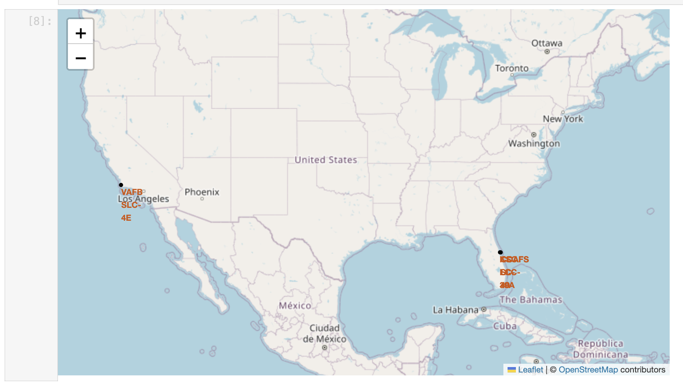
Generated Map of All Launch Sites
From the generated map, we can deduce that all launch sites are located at coastal lines. Launch site VAFB SLC-4E is located in California while Launch sites CCAFS LC-40, CCAFS SLC-40 and KSC LC-39A are all located in the same area of Florida.

Slide 36
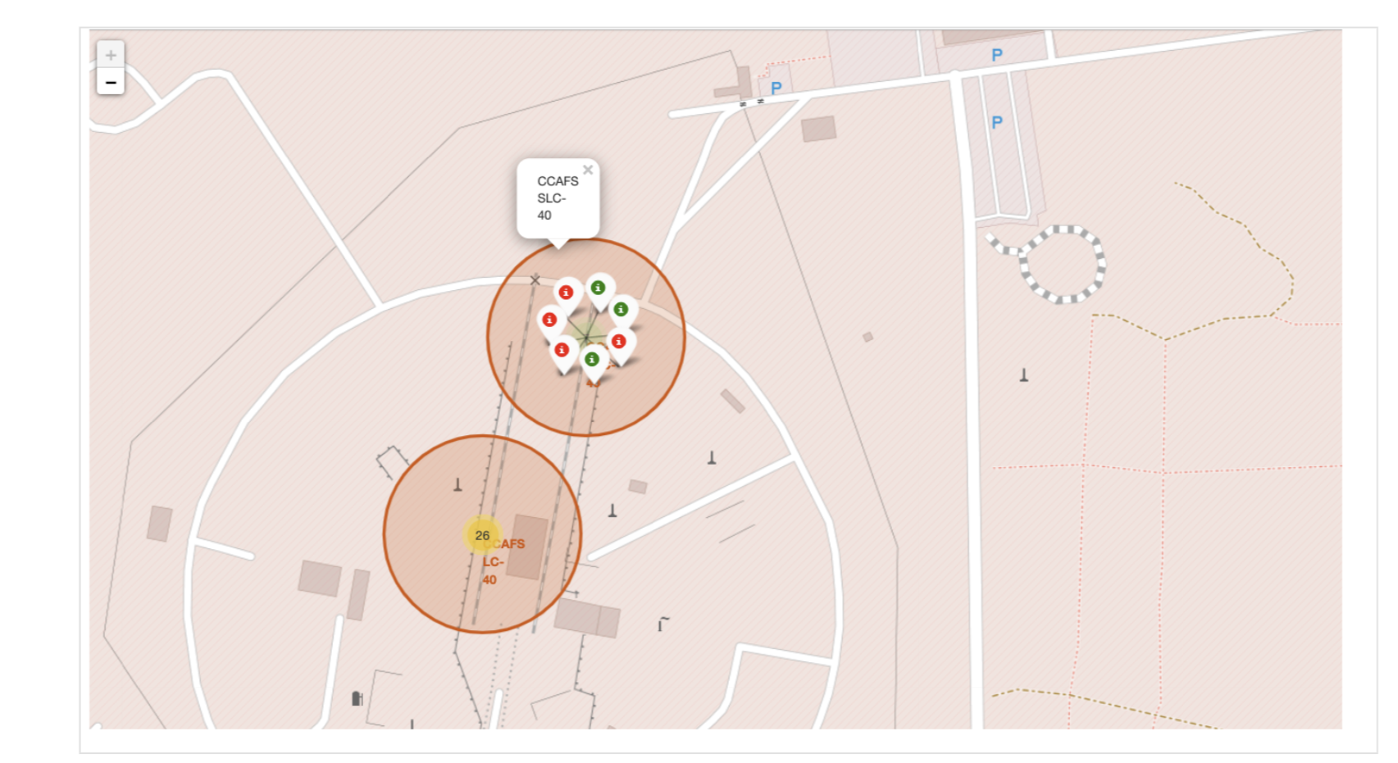
Color Labeled Map of Launch Outcomes
From the generated map, launch site CCAFS SLC-40 has a 43% success rate and a 57% failure rate and its in a close proximity with launch site CCAFS LC-40

Slide 37
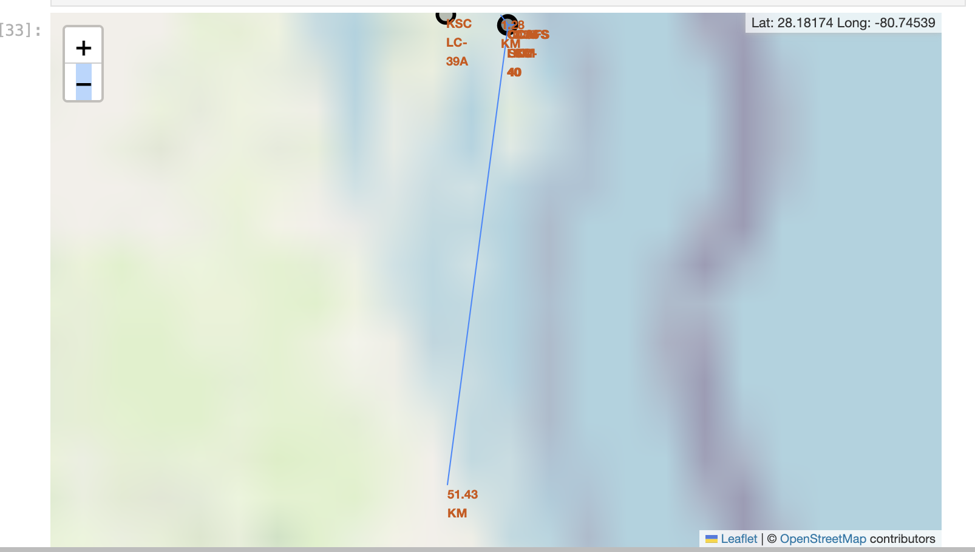
Generated Map of CCAFS SLC-40 and its Proximites
From the generated map, launch site CCAFS SLC-40 is 1.28km to the railways and therefore in close proximity, 0.58km to the highway which is also in close proximity, coastline is 0.86km to the launch site which is also in close proximity but 51.43km to the city which is a hugh distance compared to the rest.

Slide 38

Section 4

Slide 39
Success Count for All Launch Sites
Explain the important elements and findings on the screenshot
From the piechart, launch site KSC LC-39A has the highest launch success count, while launch site CCAFS SLC-40 has the lowest launch success count

Slide 40
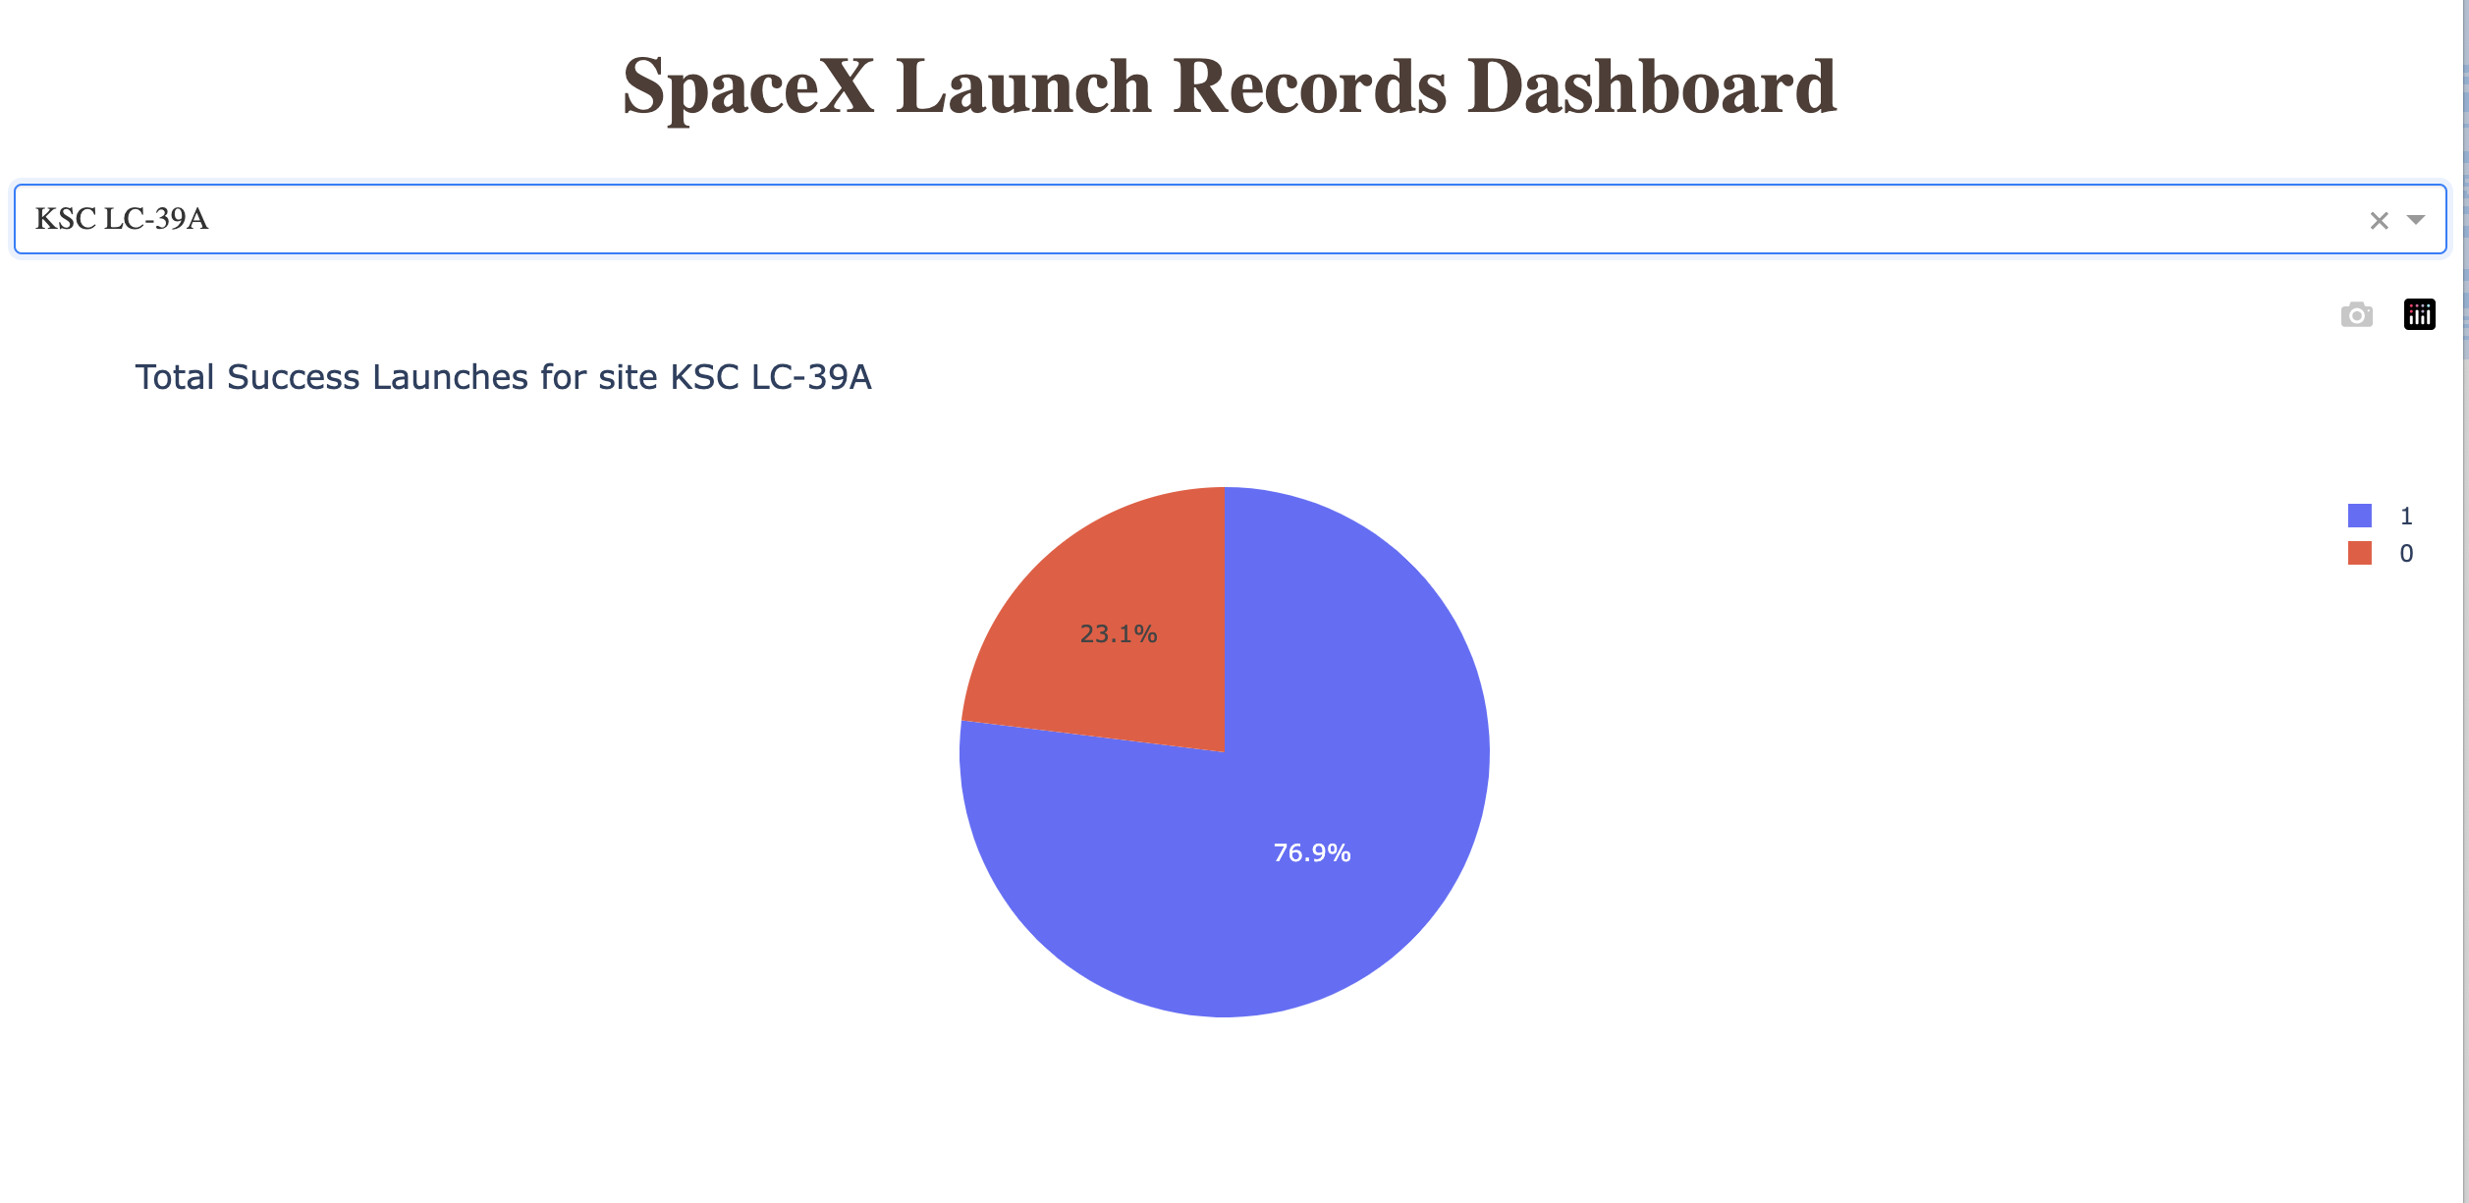
Total Success Count for site KSC LC-39A
From the piechart, there is a 76.9% success rate in launch site KSC LC-39A to 23.1% failure rate. The purple color in the legend which says 1 signifies success while the orange color which says 0 signifies fail.

Slide 41
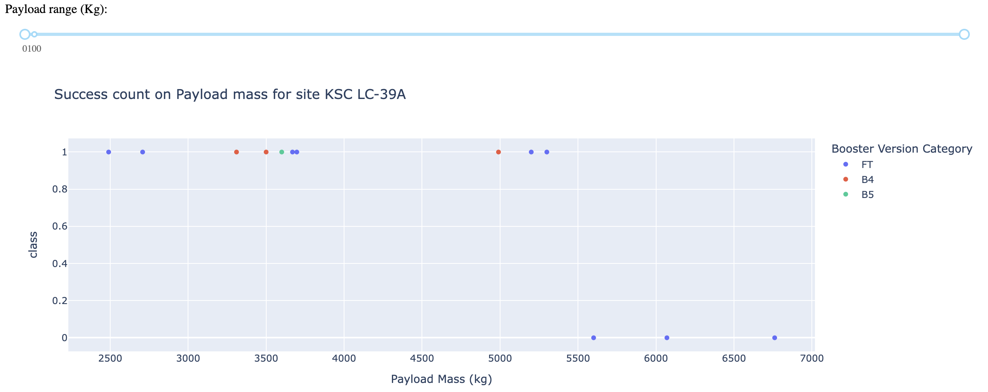
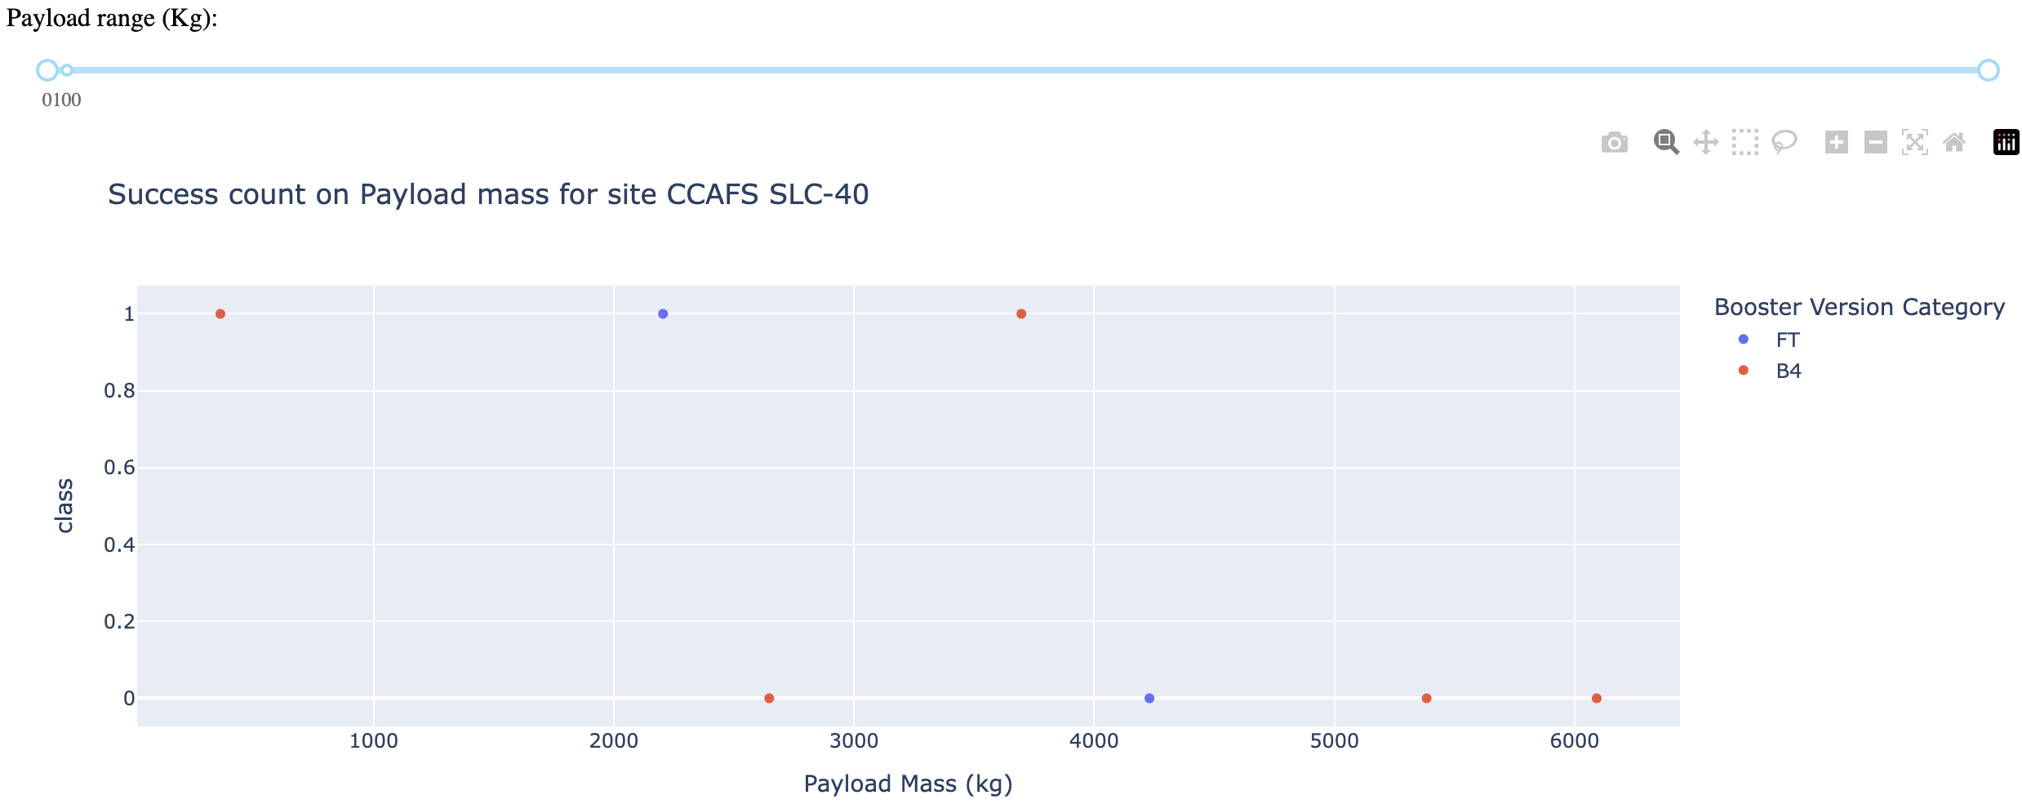
Success Count on Booster Version and Payload Mass
From the scatter plot, we can see that for site KSC LC-39A, which is said to be the most successful launch site, booster version B4 has 100% success rate but FT has a success rate of 100% if the payload mass is less than 5500 and 0% if it is above. Meanwhile for site CCAFS SLC-40, B4 booster version has a success rate of 40% while booster version FT has a success rate of 50%.

Slide 42

Section 5

Slide 43
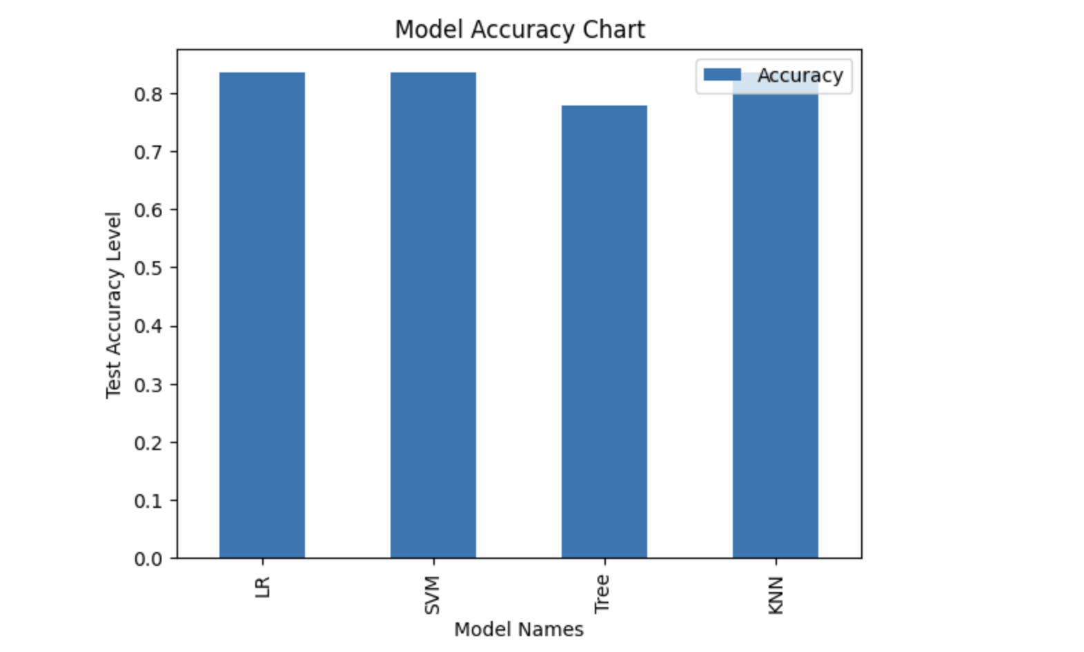
Classification Accuracy
From the model accuracy chart, logistic regression, support vector machine and k nearest neighbor performed best with an accuracy of 83.33% unlike the decision tree classifier with an accuracy of 77.8%.

Slide 44
Confusion Matrix
From the confusion matrix, we can see that there’s a true label and a predicted label. A true label is what actually happened while a predicted label is what was predicted to happen. We can see that 12 was predicted to land and they landed, so that is a TP, while 0 was predicted to not land, that is FN. 3 was also predicted not to land and 3 didn’t land, rather 12 so that is TN. Lastly 3 was predicted to land but 3 didn’t land so that is FP. TP (true positive), FN(false negative), TN(true negative), FP(false positive).

Slide 45
Conclusions
Landing outcome depends on flight parameters like launch sites, payload mass, the orbit which it is launched into and the boosters.
Launch sites are closer to places like railway lines and the coastlines but farther from the cities.
Orbits such as ES-L1, GEO, HEO and SSO had the highest success rate.
Launch success rate kept increasing overtime.
KSC LC-39A had the highest launch site success rate.
Models such as Logistic Regression, Support Vector Machine and K-Nearest Neighbor had the highest test accuracy of 83.3%

Slide 46
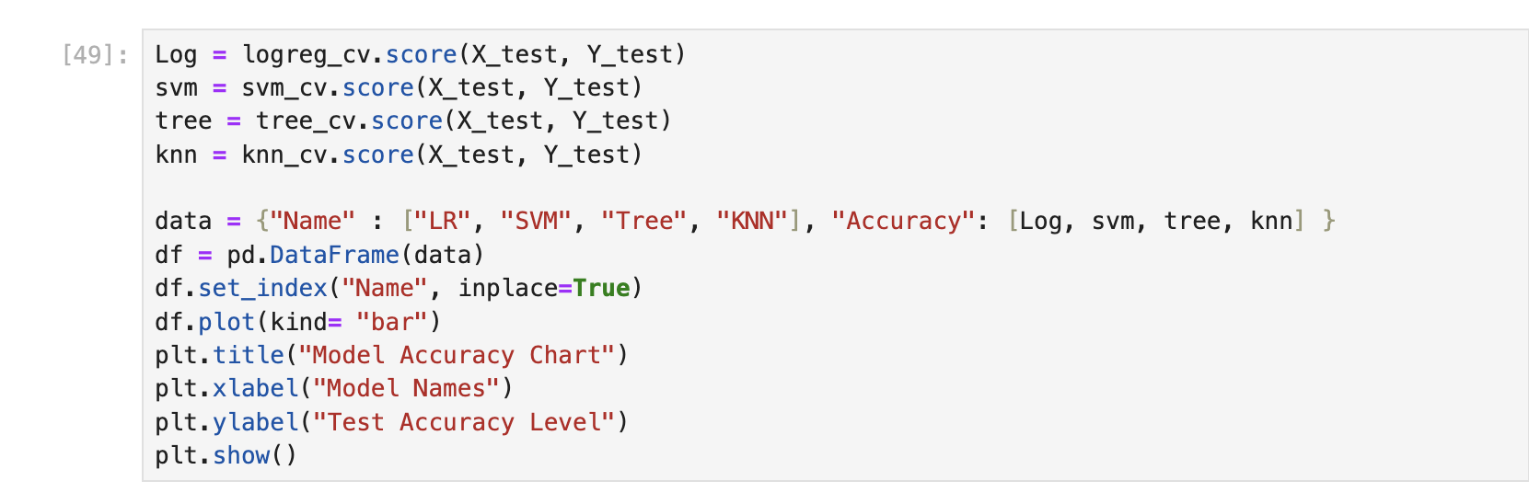
Appendix
Code snippet for the model accuracy chart

Slide 47


